Slide 1
Biochem 3BP3 Advances in DNA Sequencing

Slide 2
Sequencing Trade-Offs
Two sequencing paradigms are currently prevalent
Sanger DNA sequencing (low volume) 500-1200 bp via sequencing by synthesis and fragment migration technologies (gel or capillary)
Illumina DNA sequencing (high volume) 250 bp via massively parallel sequencing by synthesis and optical technologies (i.e. labeled bases)
Choice of technology involves trade-offs:
Length of sequencing reads
Ability to generate mate-pair reads
Volume of sequencing reads
Speed of DNA sequencing
Cost of DNA sequencing
Quality of sequencing reads

Slide 3
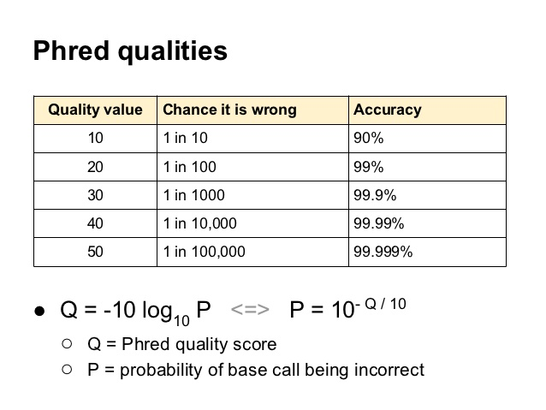
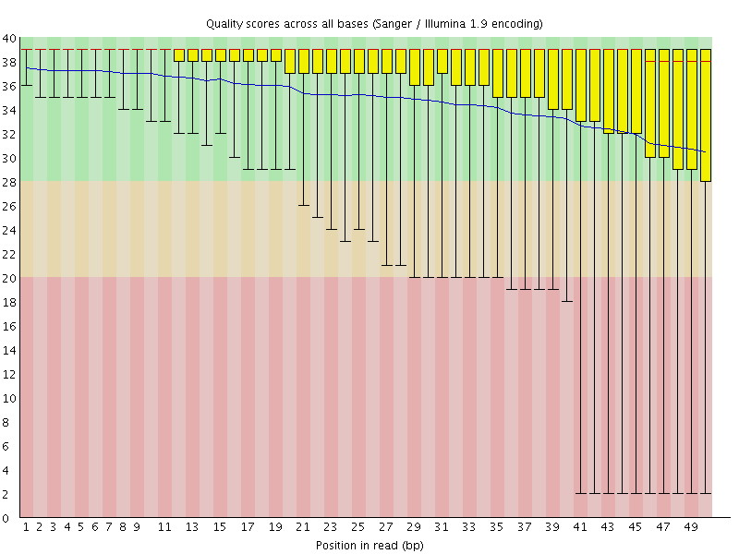
Sequencing Trade-Offs
PHRED quality is a very important concept
Length of read and quality of read are inter-dependent in both Sanger and Illumina sequencing approaches – can this relationship be decoupled?

Slide 4
Sequencing Trade-Offs
Illumina is the dominant technology currently
Short reads, but good quality
Massively parallel and thus high volume
Mate paired
Confidence obtained by high coverage
But Sanger sequencing still considered the gold standard for verification of results, e.g. confirmation of SNPs discovered by exome sequencing
Illumina short read sequencing is not the optimal data for every question
It is perfect for 16S microbiome profiling
It makes genome or transcript assembly very difficult and very noisy
A $1000 human genome is within reach
Exome sequencing of clinical samples is already affordable
But fast, real-time clinical sequencing is not yet possible – speed and infrastructure remain issues

Slide 5
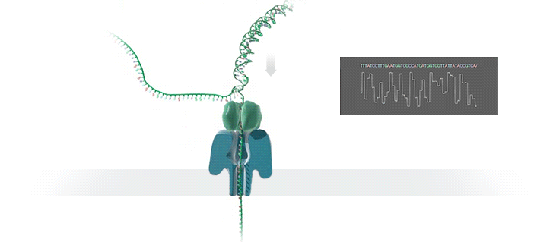
What’s Next – Nanopore MinION
A protein nanopore is set in an electrically resistant polymer membrane
An ionic current is passed through the nanopore by setting a voltage across this membrane
Change in current used to identify the molecule passing through

Slide 6
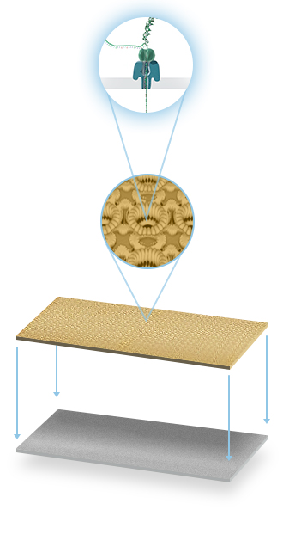
What’s Next – Nanopore MinION
Changes in current can identify bases but also modified bases
Nanopores arrayed on a single chip using microscaffolds and microelectrodes for each nanopore
Each nanopore sequences a single DNA molecule from start to finish – no fixed read length! (longest reported is 200 kb)

Slide 7
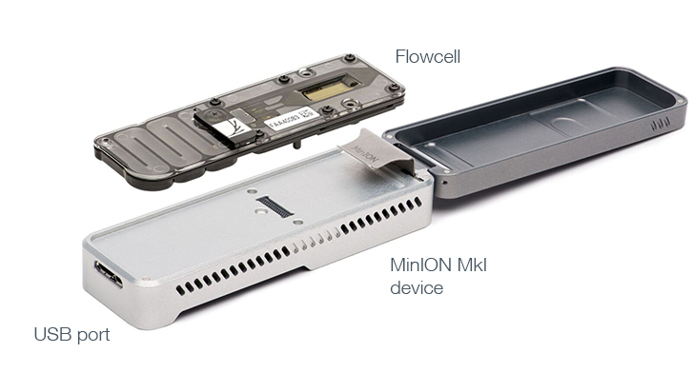
What’s Next – Nanopore MinION
Flowcell and overall device very small and portable
Easy to use – no PCR step involved, submit simple DNA extracts
DNA strand moves rapidly at the rate of 1-5 μs per base through the nanopore
Processing of fast signal not yet mature – higher DNA sequencing error rate than other technologies - per base accuracy of the MinION has been reported as 65 - 80%
Long MinION reads combined with higher quality Illumina read coverage a boon for genome assembly
May be the first technology for clinical virus sequencing and outbreak management

Slide 8
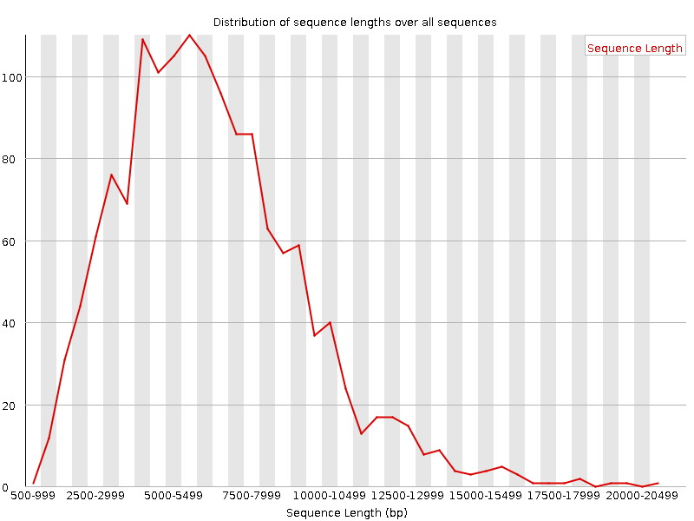
Nanopore Sequence Lengths
1478 total sequences produced by sequencing a bacterial pathogen

Slide 9
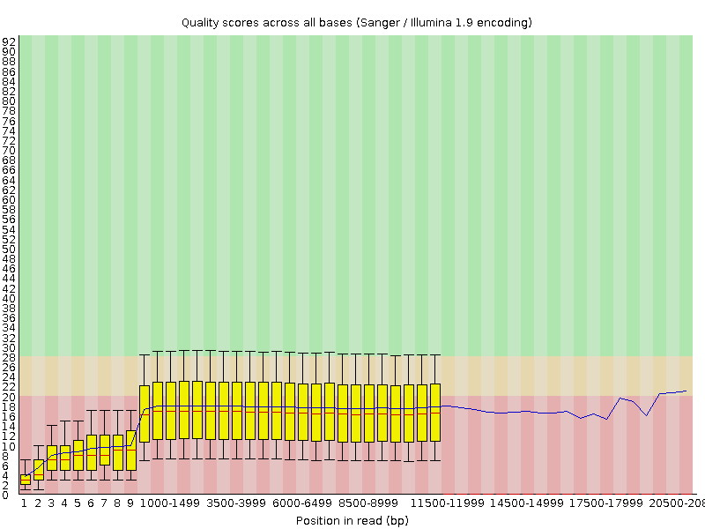
Nanopore Sequence Quality

Slide 10
Nanopore Sequencing - Implications
minION produces 25-42 Gb in 48 hours; proposed PromethION will produce 7-12 Tb in 48 hours (can you hear Kryder weeping?)
Read length and PHRED scores decoupled. Can the PHRED performance be improved?
Complete single pass genome or chromosome sequencing may be possible
Assembly algorithms may not be needed
No PCR or sequencing by synthesis – few consumables – cheaper!
Fast technology – clinical application
Density of nanopores may allow sequencing of complete microbiomes
Bacteria & Viruses
Both pathogen identification and gene content
PromethION sequencing of an entire transcriptome?

Slide 11
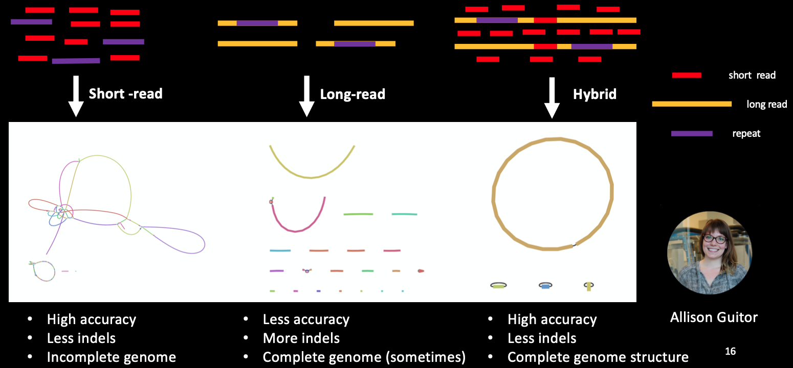
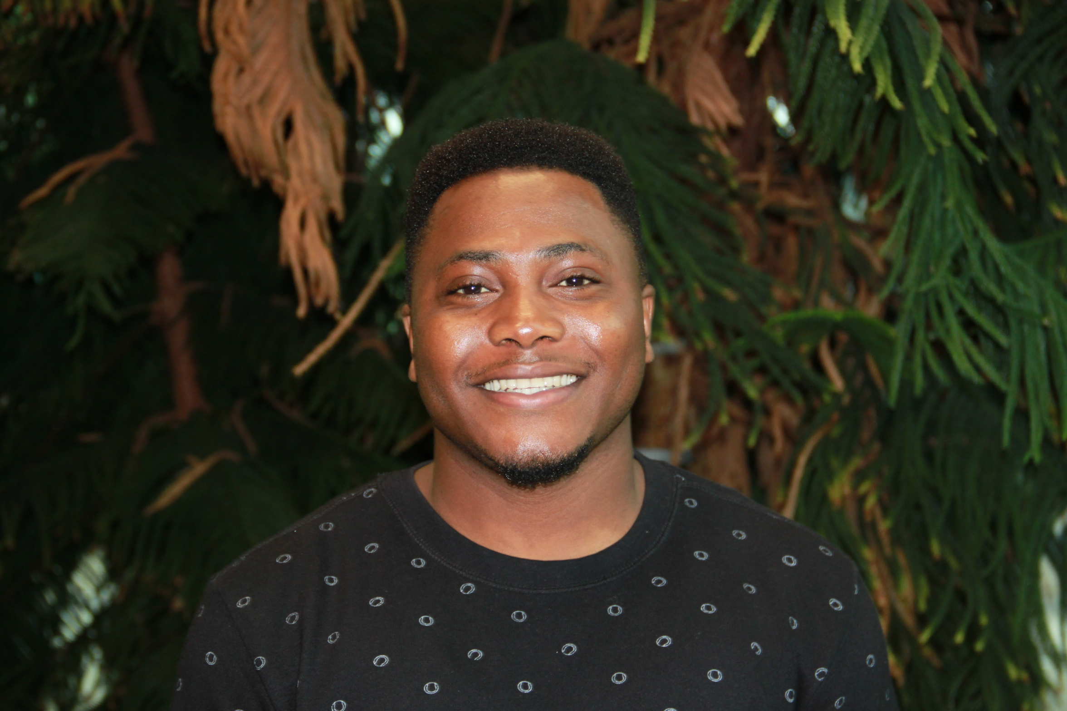
Nanopore Sequencing - Implications
Martins Oloni

Slide 12
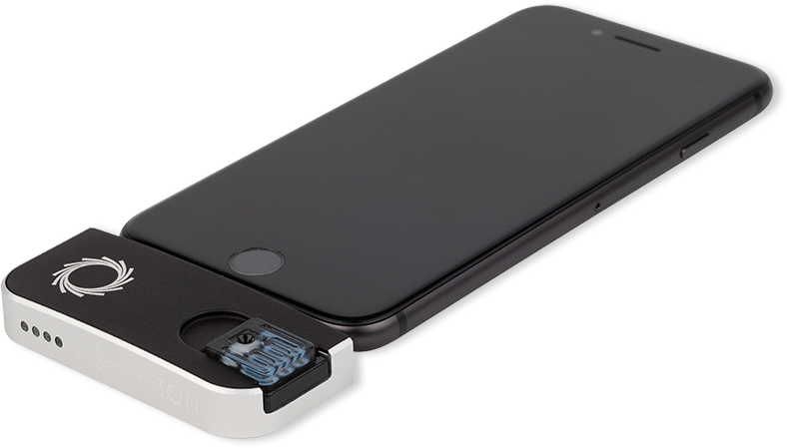
Nanopore Sequencing – Miniaturization!
SmidgION

Slide 13
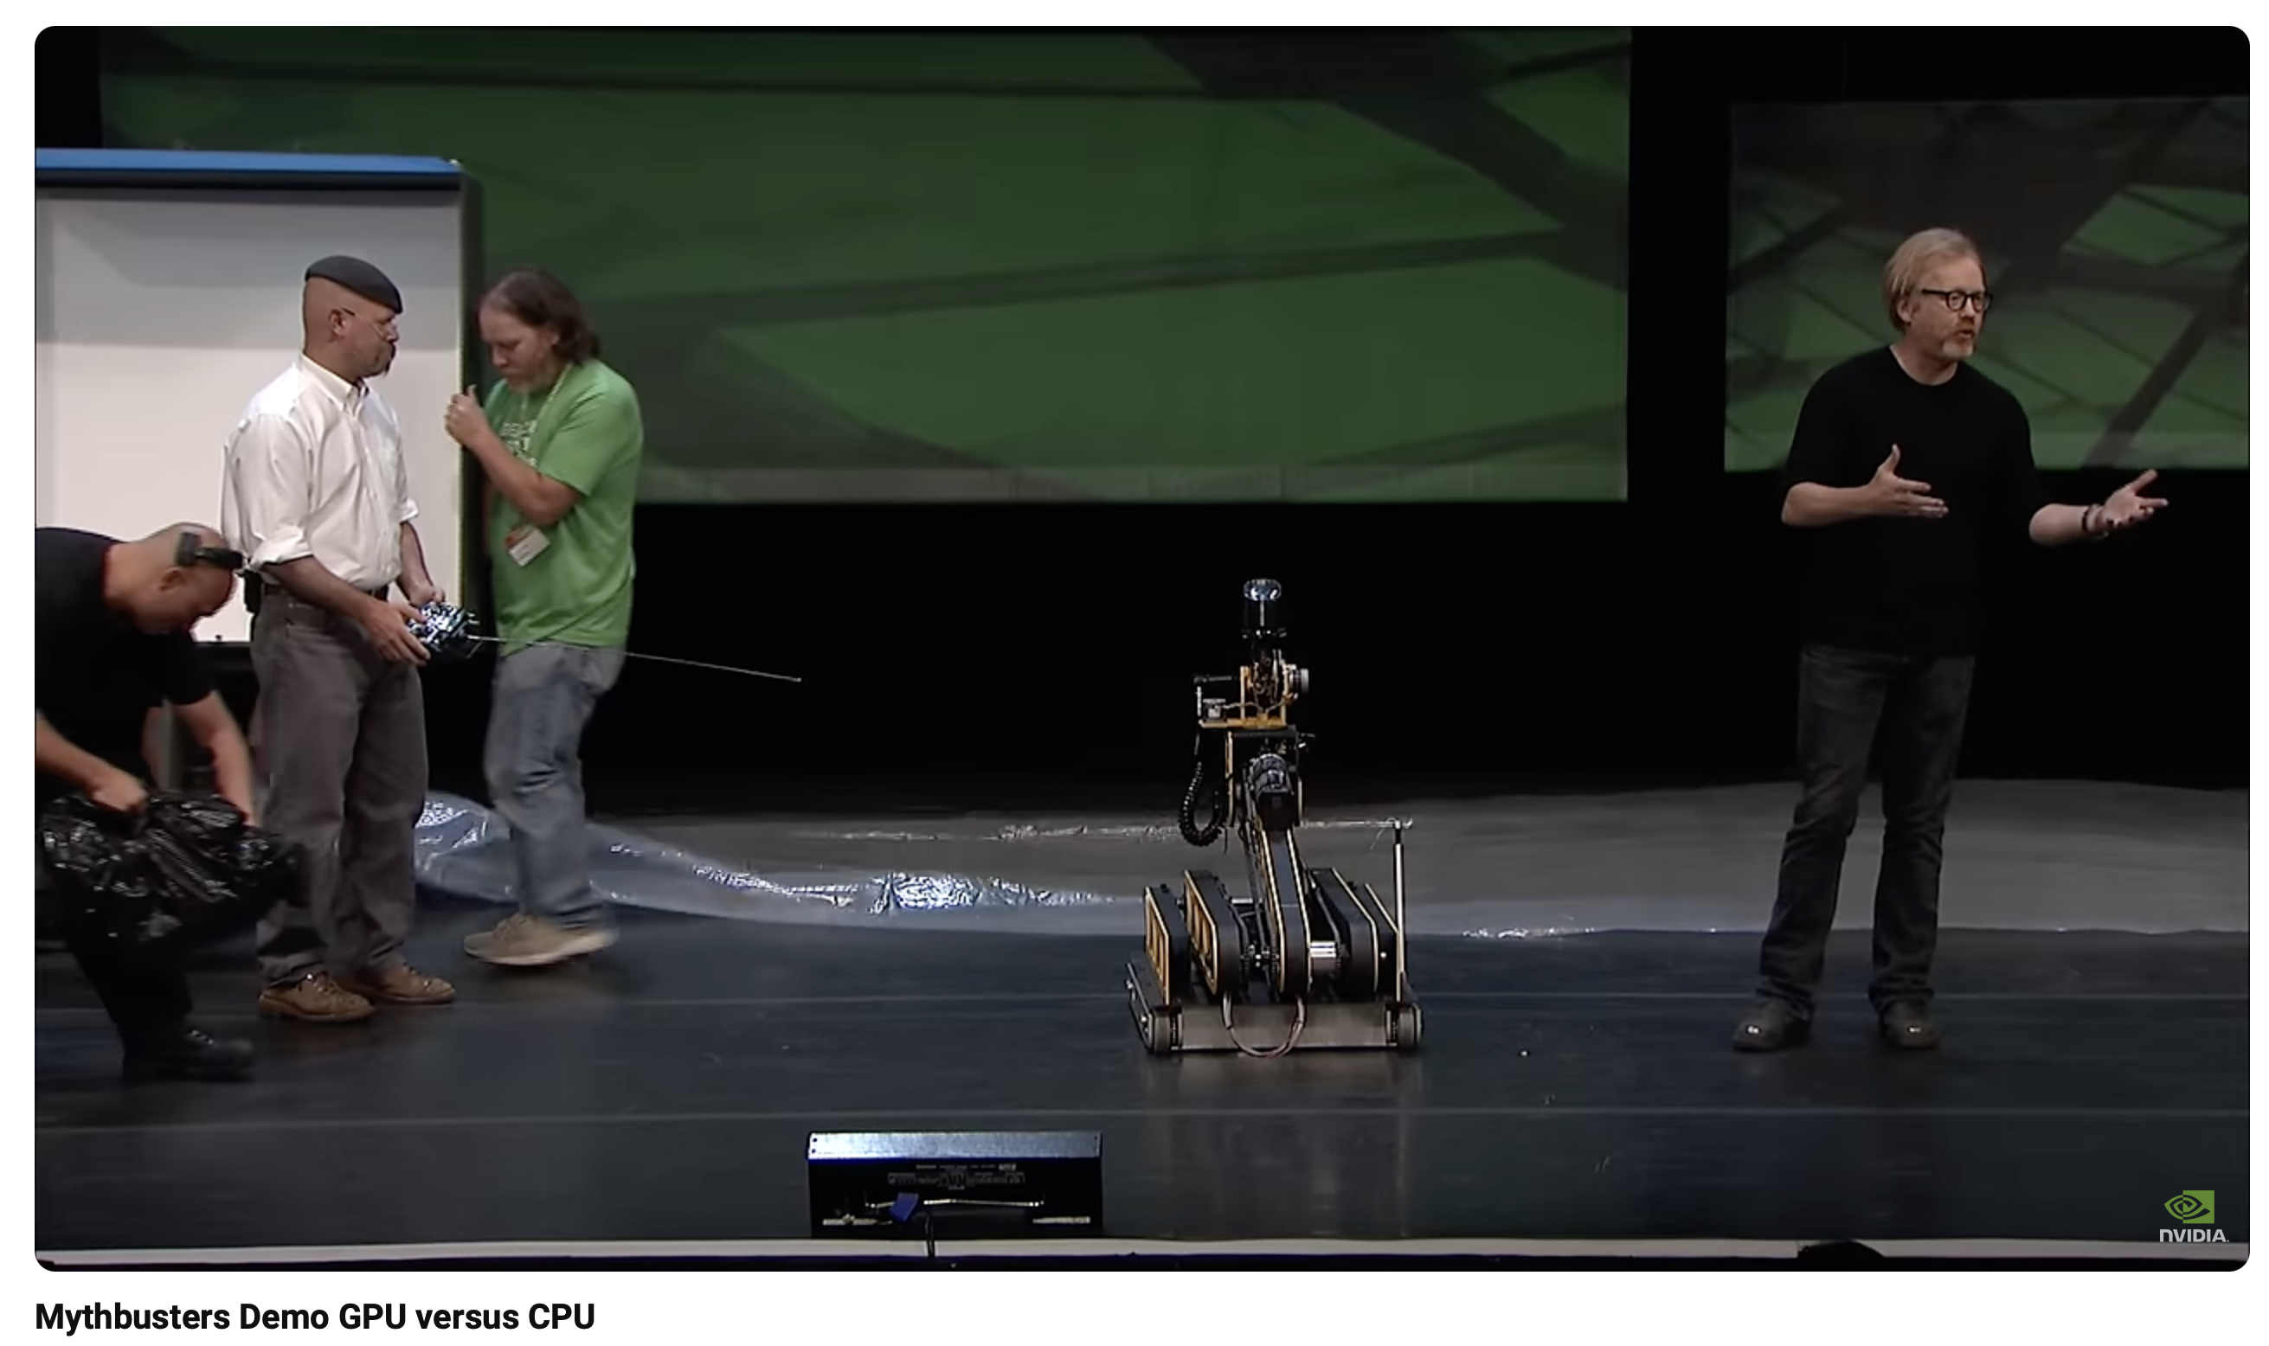
Increasing Use of GPU Technologies
CPU– Central Processing Unit
“Swiss Army Knife” of computing - can run a variety of programs quickly
Ubiquitous – your computer, your fridge, your car, your phone, etc.
Computes in series, i.e. one calculation after another
GPU – Graphic Processing Unit
“Video card” for display; driven by the gaming industry
Run one kind of computation simultaneously, very quickly
Can be re-purposed for bioinformatics
CPU versus GPU
GPU does not do well for sequence similarity (i.e. BLAST) or read mapping
GPU does very well for signal processing – Nanopore reads!
GPU be cost effective for large projects, but custom software or re-programming required
A silly demonstration: https://www.youtube.com/watch?v=-P28LKWTzrI

Slide 14
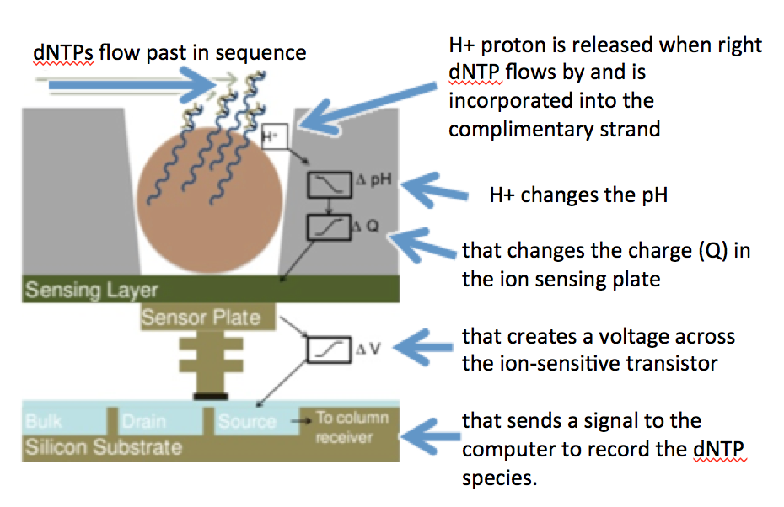
What’s Next – Ion Torrent
Semi-conductor DNA sequencing instead of Illumina optical detection
Still involves sequencing via synthesis so unlikely to be as affordable as nanopore technologies

Slide 15
What’s Next – Ion Torrent
Volume and data are similar to Illumina but…
Mate pairs not possible
PHRED scores not as high
Lower cost per base and faster run time but technology is analogous to Illumina – massively parallel short reads
The need for massively parallel short read technologies is not yet going away, particularly for large complicated RNA/DNA samples
Which technology will persist – optical detection or semi-conductor sequencing?

Slide 16
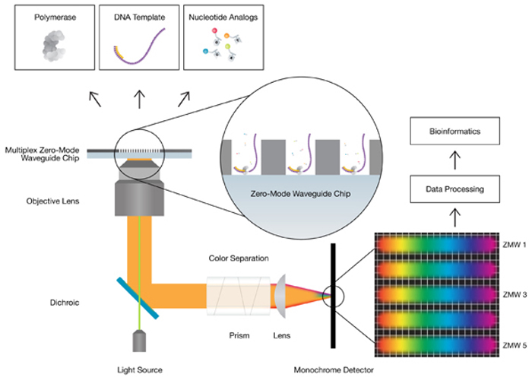
What’s Next – PacBio
Single Molecule, Real-Time (SMRT) technology - claimed long reads, uniform coverage, and high consensus accuracy
Also a sequence by synthesis method with phospholinked nucleotides but has a novel sensor: zero-mode waveguides (ZMWs)
A single DNA polymerase enzyme is affixed at the bottom of a ZMW with a single molecule of DNA as a template

Slide 17
What’s Next – PacBio
As nulceotides are incorporated, the ZMW detects the release of the flourescent tag – sequencing by synthesis
Immobilized DNA polymerase is stable enough for long reads: average > 10,000 bp, some reads > 60,000 bp
Single polymerase – single template sequencing has orders of magnitude less consumable needs than Illumina sequencing by synthesis

Slide 18
What’s Next – PacBio
Cost is still high due to technology costs, but that is expected to drop
PHRED error rates remain higher but each SMRT cell generates ~55,000 reads so error is offset by coverage (except for bias!)
Greatly simplifies the genome sequencing problem, particularly for bacteria
Combined with low volume Illumina sequencing, bacterial genomes can be much more easily resolved

Slide 19
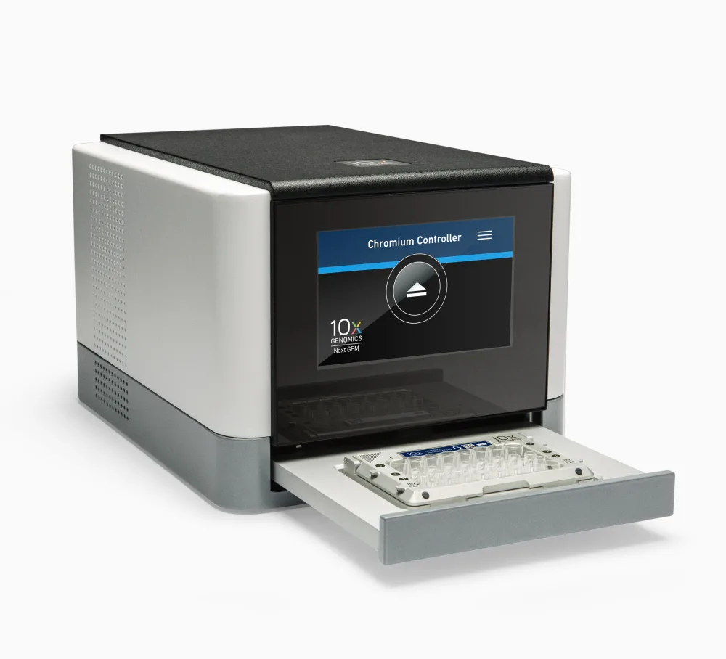
10x Genomics single-cell sequencing platform
Combine cell sorting with DNA sequencing
Small footprint – fit it in the BSL3 lab
Single cell transcriptomics!
Big implications for cancer research (i.e. stem cells) and infectious disease (i.e. virus impact by cell type)

Slide 20
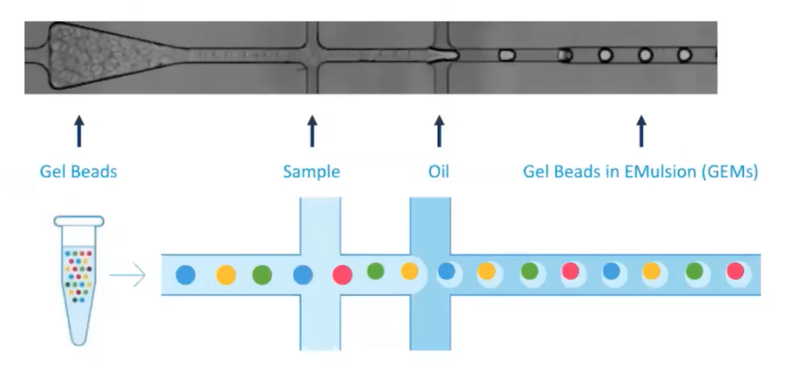
10x Genomics single-cell sequencing platform
Combine cell sorting with DNA sequencing
Small footprint – fit it in the BSL3 lab
Single cell transcriptomics!
Big implications for cancer research (i.e. stem cells) and infectious disease (i.e. virus impact by cell type)

Slide 21
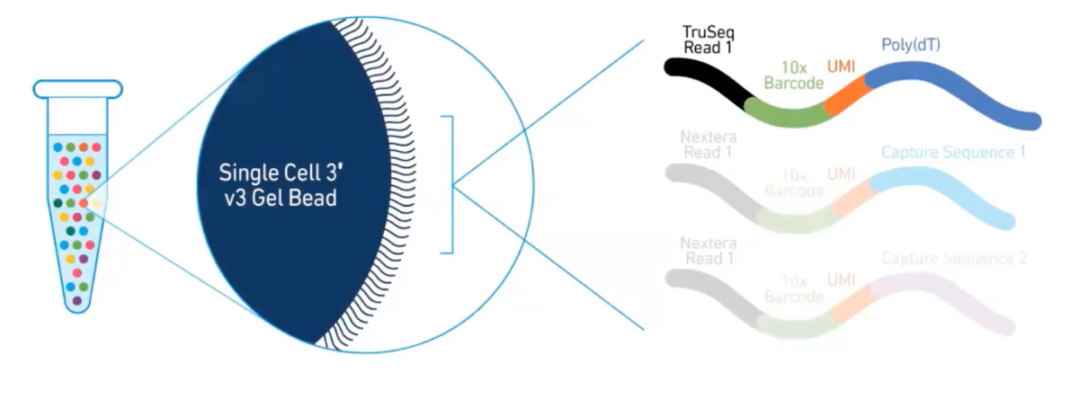
10x Genomics single-cell sequencing platform
Combine cell sorting with DNA sequencing
Small footprint – fit it in the BSL3 lab
Single cell transcriptomics!
Big implications for cancer research (i.e. stem cells) and infectious disease (i.e. virus impact by cell type)

Slide 22
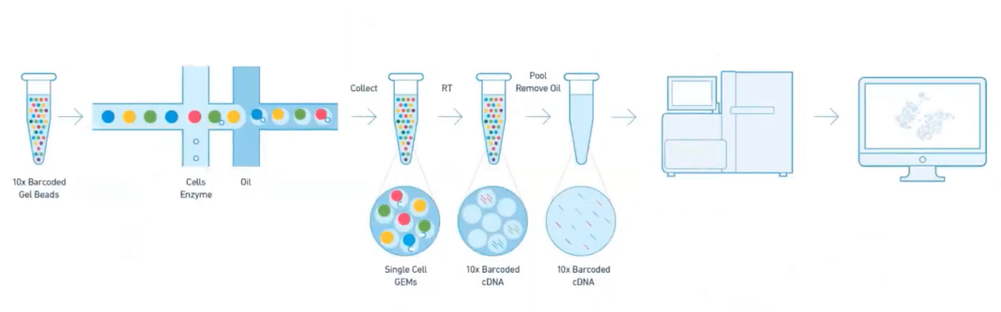
10x Genomics single-cell sequencing platform
Combine cell sorting with DNA sequencing
Small footprint – fit it in the BSL3 lab
Single cell transcriptomics!
Big implications for cancer research (i.e. stem cells) and infectious disease (i.e. virus impact by cell type)

Slide 23
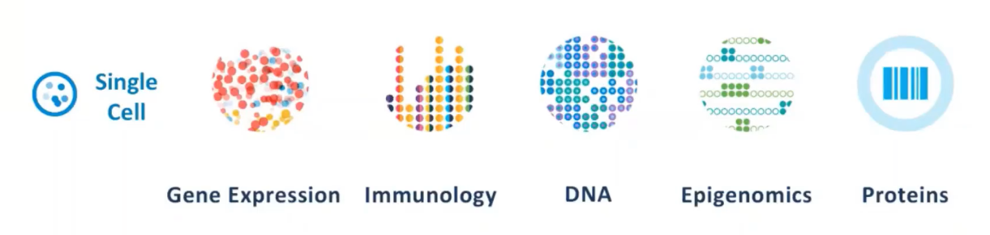
10x Genomics single-cell sequencing platform
Combine cell sorting with DNA sequencing
Small footprint – fit it in the BSL3 lab
Single cell transcriptomics!
Big implications for cancer research (i.e. stem cells) and infectious disease (i.e. virus impact by cell type)

Slide 24
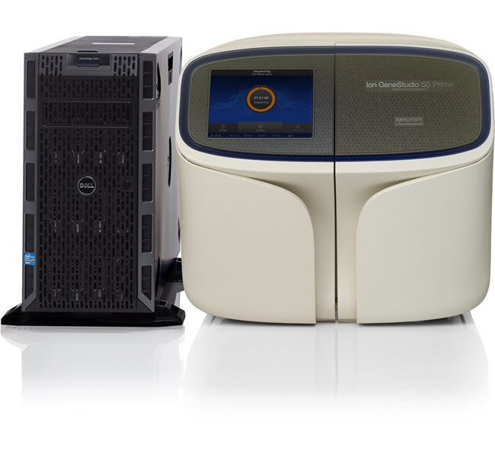
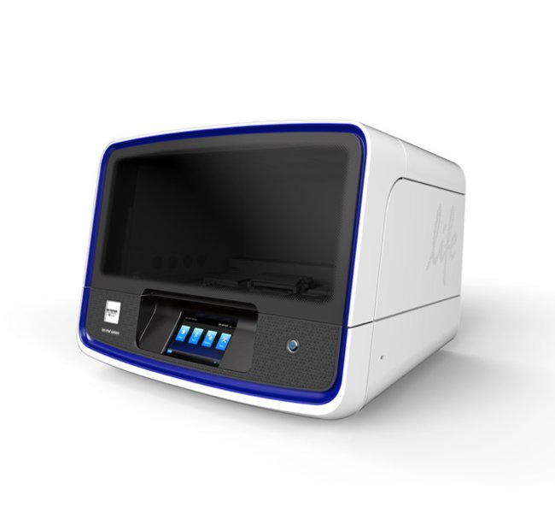
Ion Gene Studio S5 Prime & Ion Chef
Ion Torrent Single Molecule, Real-Time (SMRT) technology with maximum throughput and rapid turnaround time
2–130 million reads per run
Low sample input
Less than 24 hour turnaround time
Low error rate (99.5% accuracy)
Pandemics - real time outbreak response; 2-50 Gb of sequencing per day; 1500+ SARS-CoV-2 genomes per day!
Ion Chef full automates library construction, template preparation, and chip loading in less than 15 minutes!

Slide 25
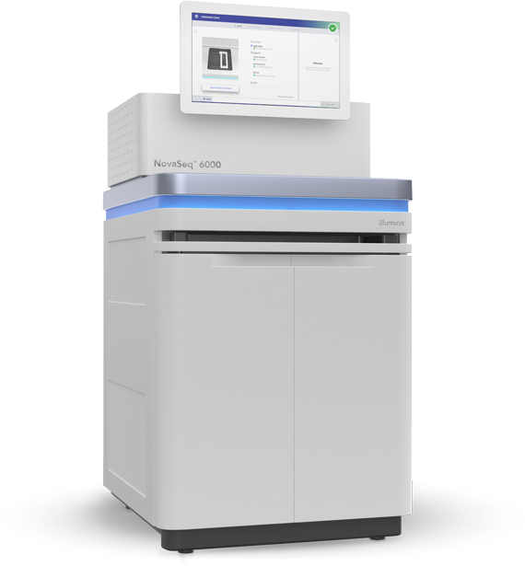
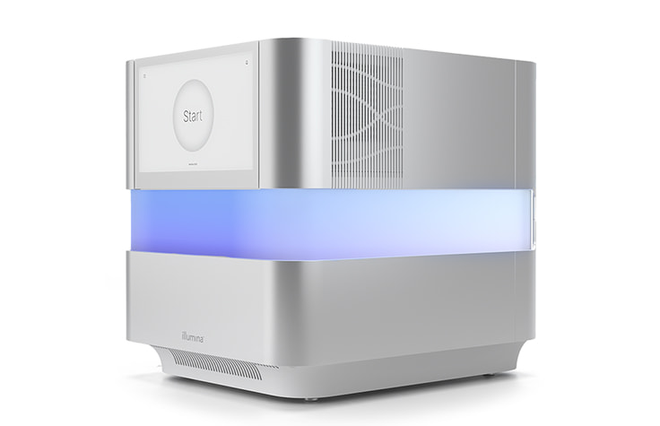
Illumina NovaSeq 6000 versus NextSeq 1000 & 2000
NextSeq 1000 & 2000 NovaSeq 6000
330 Gb output 6000 Gb output
11-48 hours 13-44 hours
1.1 billion reads per run 20 billion reads per run
2 x 150 bp 2 x 250 bp

Slide 26

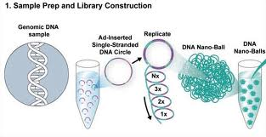
MGI DNA Sequencers
DNA nanoball and combinatorial probe anchor synthesis
Rolling circle amplification leads to creation of DNA nano-balls (DNBs)

Slide 27
MGI DNA Sequencers
DNA nanoball and combinatorial probe anchor synthesis
No amplification bias
Rolling circle amplification leads to creation of DNA nano-balls (DNBs)

Slide 28
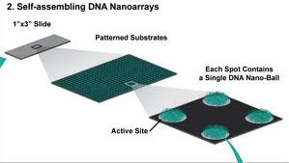
MGI DNA Sequencers
DNA nanoball and combinatorial probe anchor synthesis
No amplification bias
Array has 2+ billion spots – one DNB per spot via self-assembly

Slide 29
MGI DNA Sequencers
DNA nanoball and combinatorial probe anchor synthesis
No amplification bias; no ligation bias
Array has 2+ billion spots – one DNB per spot via self-assembly

Slide 30
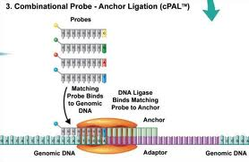
MGI DNA Sequencers
DNA nanoball and combinatorial probe anchor synthesis
No amplification bias; no ligation bias
Combinatorial Probe-Anchor Ligation (cPAL) sequencing, i.e. hybridization of dye-labelled probes

Slide 31
MGI DNA Sequencers
DNA nanoball and combinatorial probe anchor synthesis
No amplification bias; no ligation bias
Novel base & read calling bioinformatics – PHRED scores?
Combinatorial Probe-Anchor Ligation (cPAL) sequencing, i.e. hybridization of dye-labelled probes

Slide 32
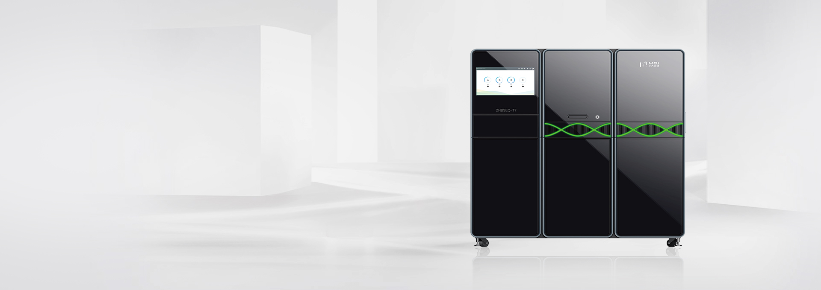
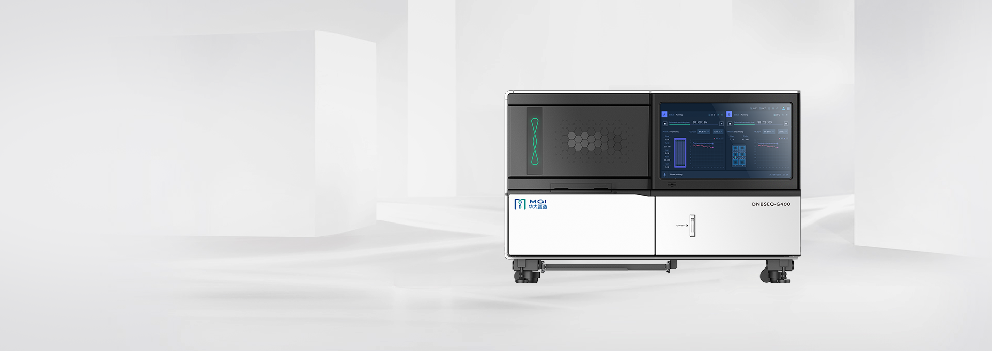
MGI DNA Sequencers
DNA nanoball and combinatorial probe anchor synthesis
No amplification bias; no ligation bias
Novel base & read calling bioinformatics – PHRED scores?
DNBSEQ-T7
6 Tb of data
5 billion reads
24 hours
2 x 150 bp
DNBSEQ-G400
1440 Gb of data
1.8 billion reads
30-100 hours
2 x 200 bp or 1 x 400 bp

Slide 33
Conclusions
Throughput is going to continue to increase - Kryder’s law is going to be an increasing problem
Long read technologies should lead to easier bioinformatics as they overcome many of the problems of genome or transcript assembly (particularly repeats)
The PHRED paradigm will continue to be important but we will need new PHRED prediction algorithms for each new technology
Are we prepared for bioinformatics where we can completely sequence a human transcriptome or thousands of bacterial genomes in a day? Every undergraduate thesis could generate ‘Big Data’

Slide 34
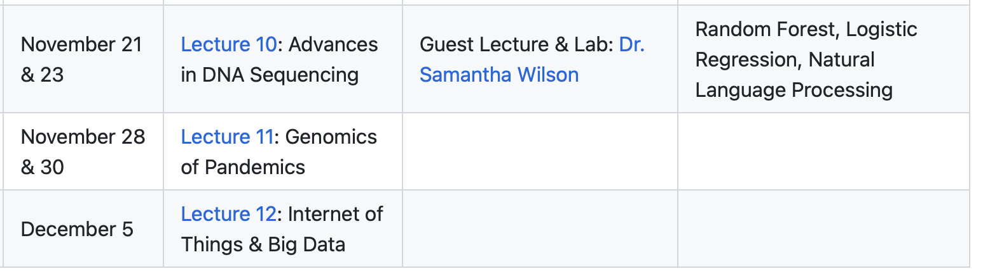
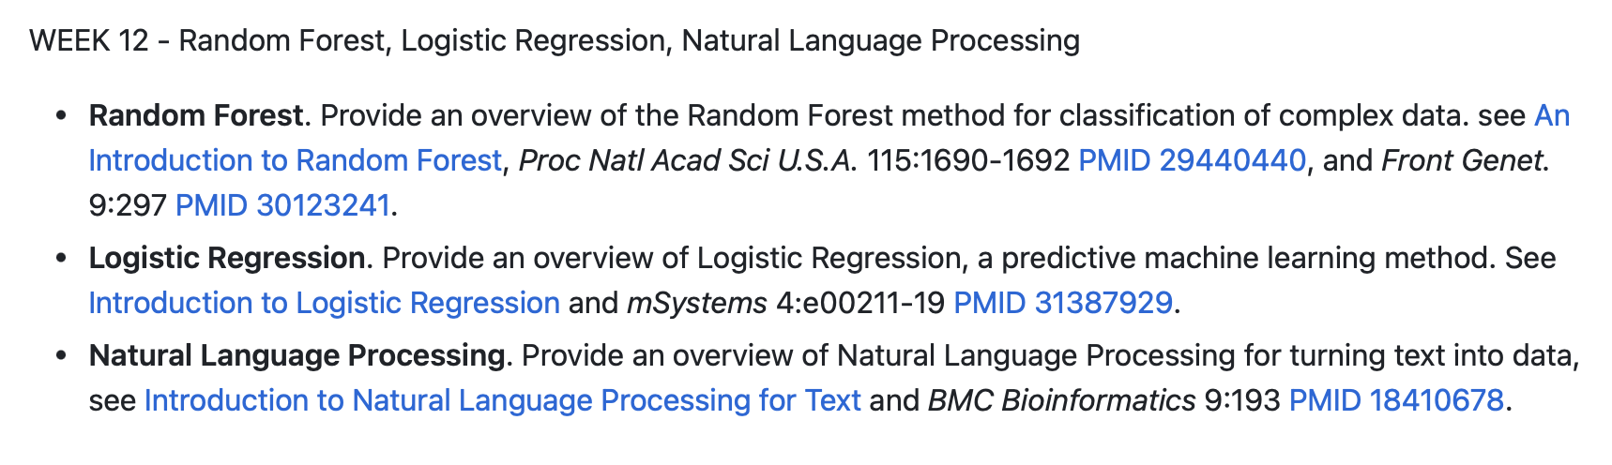
Last 3 weeks…

